Slide 1












CULTURE FUSION FEST
LAYLA DUONG, JOANNA SANCHEZ, JALISSA VEGA - TRI-INSITUTIONAL EVENT

Slide 2

INTRODUCTION
Welcome, and thank you for taking the time to review our funding proposal. We are excited to present the Cultural Celebration & Community Collaboration, an event designed to bring together students, faculty, and community members in a vibrant and inclusive environment. Our goal is to highlight cultural diversity through performances, interactive activities, and food while fostering community engagement. We are hoping to seek financial support from all institutions included to ensure the success of this event and would greatly appreciate your consideration.

Slide 3
AGENDA
Event Overview
    Date, time, and location
    Expected attendance and logistics
Why This Event Matters
    Community and cultural impact
Funding Request & Budget Breakdown
    Itemized costs
Key Event Components
    Club tabling
    Performances
    Activities and entertainment
    Raffle prizes
    Food and beverages
    Marketing and promotion
Contacts
    Information on who to contact
Conclusion & Thank You

Slide 4
EVENT OVERVIEW &WHY IT MATTERS
  Event Name: Multicultural Celebration
  Date & Time: April 29th, 12 – 4 PM
  Location: Tivoli Commons (Outdoor Event)
  Teardown Time: 5 – 6 PM
  Anticipated Peak Traffic: 1 – 3 PM
  Promotes cultural awareness and community engagement
  Provides networking opportunities for students and organizations
  Supports student clubs and local performers
  Encourages student participation through activities and entertainment

Slide 5



DRAGON & LION DANCE
FOLKLORICO
So as far as the cost it’s going to be $600
As far as this costs for the Folkloric Dance Group are going to $500
FUNDS &
BUDGET
PHOTOBOOTH
MECHANICAL BULL
The Photo Booth will be around $650 for 3 hours and unlimited prints.
The cost on the bull depends on the hours it will be used for which is typically around $500

Slide 6
KEY EVENT COMPONENT
Club Tabling
Performances
Activities & Entertainment
Raffle Prizes
Food & Beverages
Marketing & Promotion
  Opportunity for student clubs to showcase their work and recruit members
  Encourages student involvement in campus life
  Deadline for club sign-ups: April 14th
  Dragon & Lion Dance performance
  Folklorico Dance Group showcasing traditional dances
  Loteria, Squid Games-inspired challenge, piñata, cornhole, spike ball
  Mechanical Bull (Pending final approval)
  Photo Booth for event engagement
  Suggested prizes include: AirPods, iPad, Speaker, Digital Camera, Gift Cards, Backpacks
  Raffle entries will encourage participation in different activities
  Food Trucks (Final selection in progress)
  Bettys Rentals for Aguas Frescas
  Flyer finalization and distribution
  Co-sponsorship branding with SGA

Slide 7
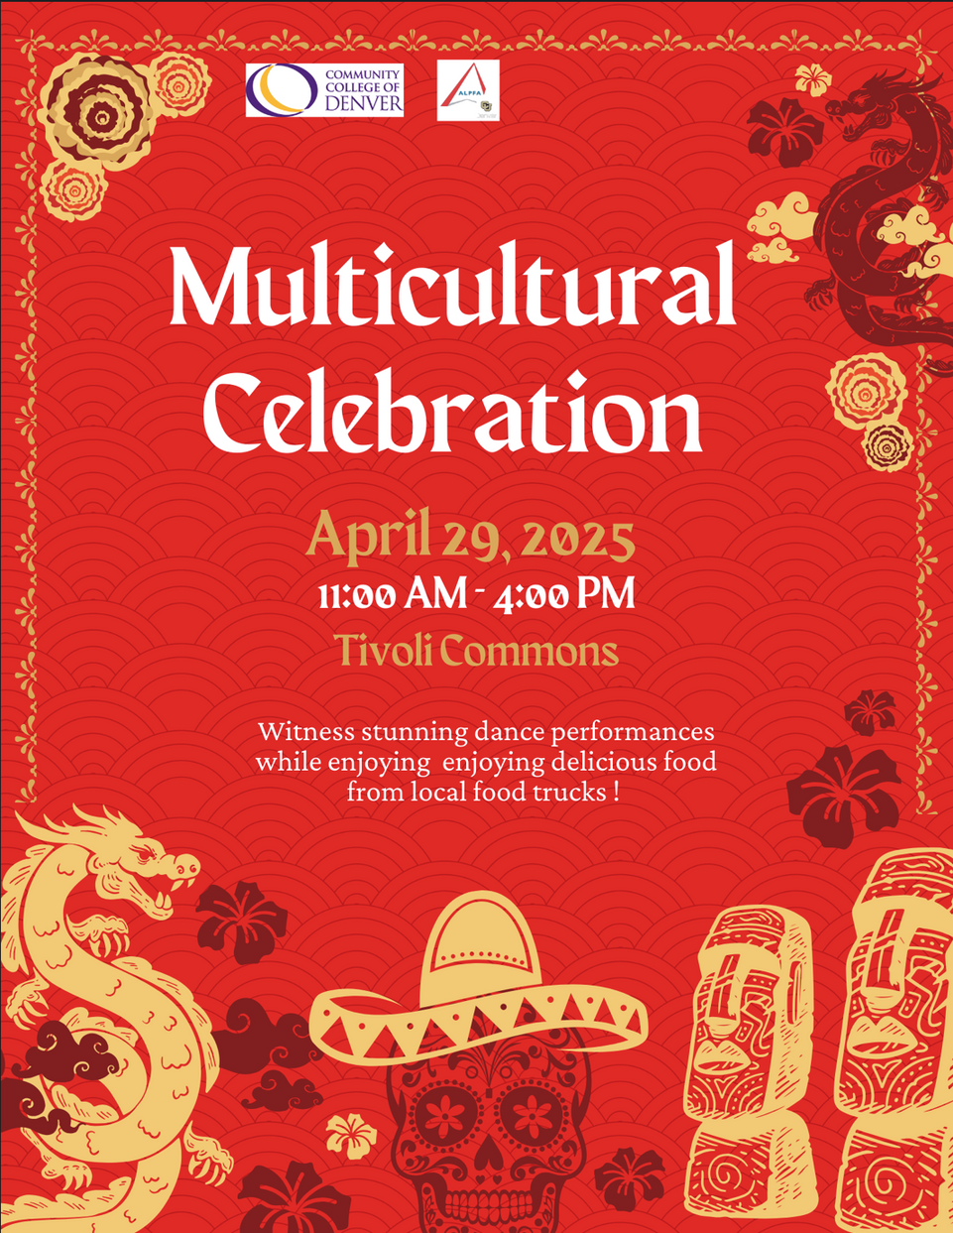
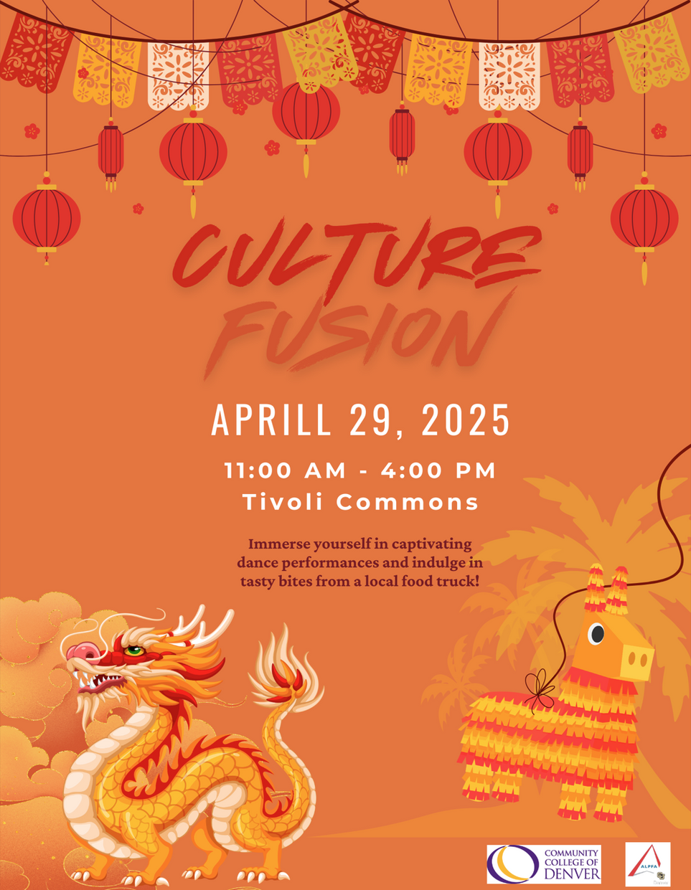

Slide 8
CONTACTS
CCD
  Layla Duong
Email: lduong6@student.cccs.edu
  Joanna Sanchez
Email: jsanchez638@student.cccs.edu
CU Denver
  Jalissa Vega
Email: Jalissa.vega@ucdenver.edu
  ALPHA
Email: alpfa@ucdenver.edu
MSU
  Patrick Cervera
Email: pcerver1@msudenver.edu

Slide 9
CONCLUSIONS
The Cultural Celebration & Community Fair is more than just an event—it is an opportunity to bring our community together, celebrate diversity, and create lasting memories. With your support, we can provide students with an enriching experience filled with cultural performances, engaging activities, and opportunities for connection. We appreciate your consideration and look forward to your support in making this event a success.

Slide 10
THANK YOU VERY MUCH!

